Slide 1


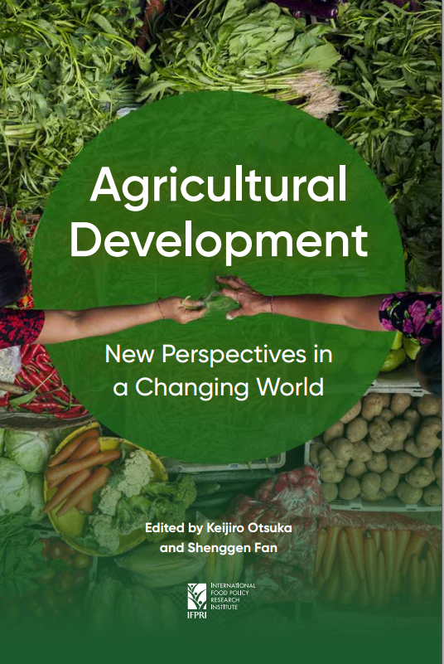
Agricultural Development in a Changing World: Global Perspective
Shenggen Fan
Chair Professor and Dean
Academy of Global Food Economics and Policy (AGFEP)
China Agricultural University (CAU)
ASAE | December 7th, 2021

Slide 2
Outline
Challenges facing hunger, nutrition and climate change
Agriculture plays a key role in broader development goals
Agricultural development must embrace an agri-food system approach

Slide 3
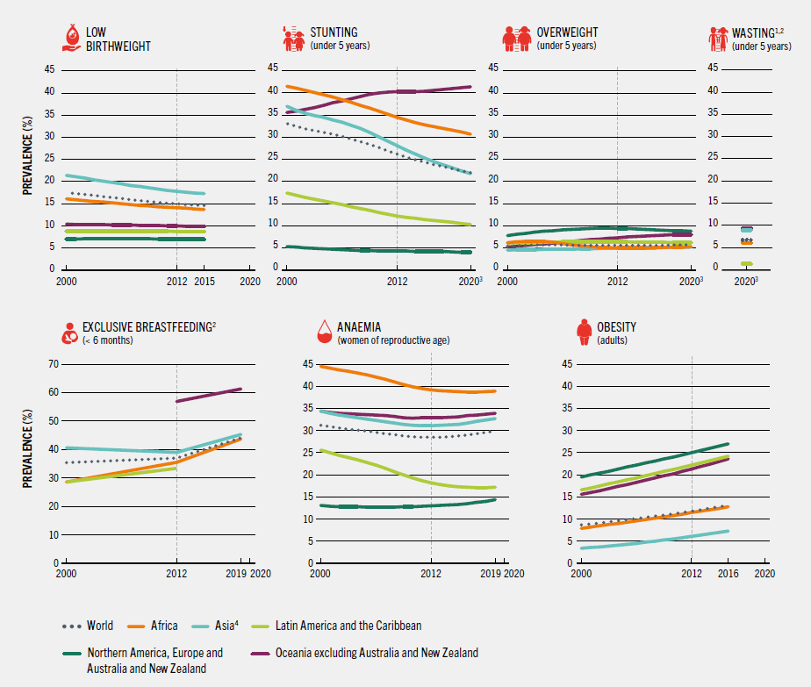
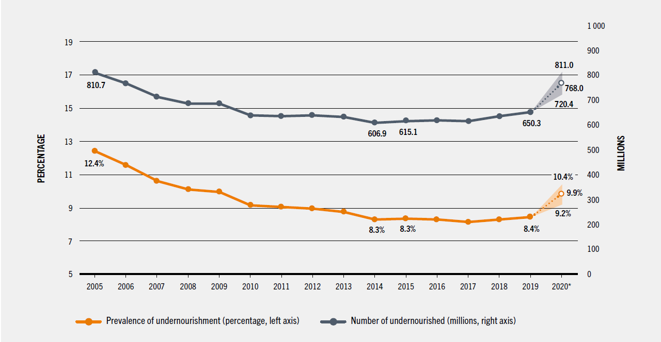
Hunger and Malnutrition
In 2020, 768 million people in the world faced hunger, an increase of 161 million compared with 2019
In 2020, nearly 2.37 billion people did not have access to adequate food, an increase of 320 million in just one year
In 2020, an estimated 22% of children under 5 years of age were affected by stunting,6.7% by wasting and 5.7% by overweight
In 2019, nearly 30% of women aged 15 to 49 were affected by anemia in 2019
Nutrition indicators
Number of undernourished people

Slide 4
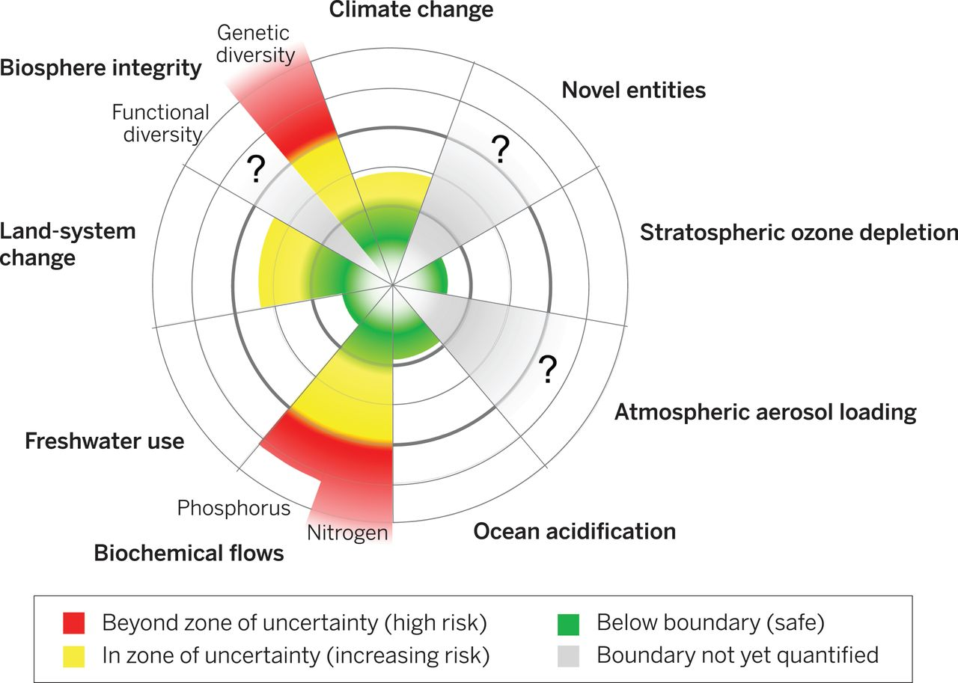
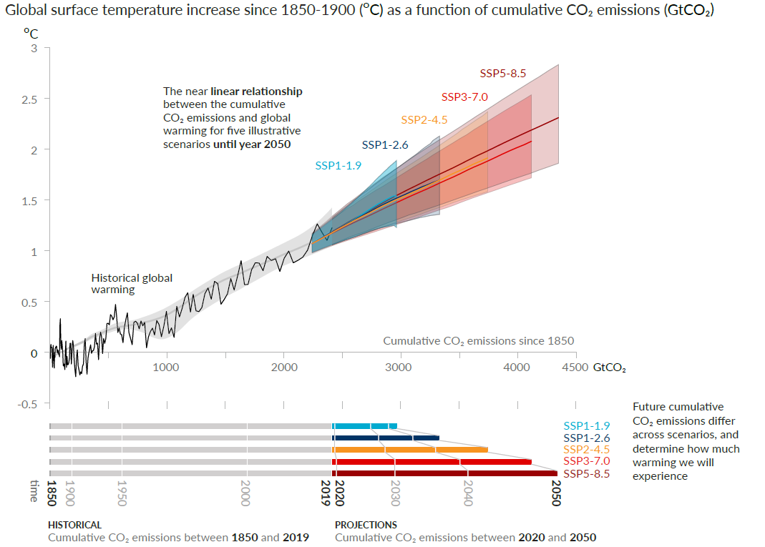
Planetary Boundary and Climate Change
The more GHG emission, the severer the global warming will be
Agrifood systems account for 31% of human-caused GHG emission(FAO,2021)
Global warming and CO2 emission

Slide 5
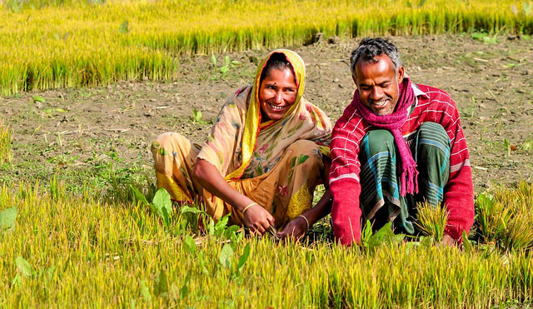
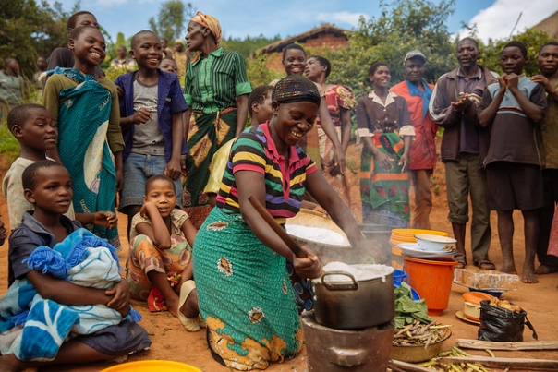
Agriculture is critical for nutrition
Agriculture-Nutrition pathways
Agriculture as a source of food (own production)
Agriculture as a source of income
Agricultural policy and food prices affecting purchasing power and consumption patterns
Agriculture income’s effect on spending patterns
Gender dimensions (rural women)
Women’s status and intra-household decisions and resource allocation
Women’s ability to care for young children
Women’s own nutritional status

Slide 6
Agriculture and food affect health
Producers
Consumers
Increased productivity & production of nutritious & healthy food
  Impact health of smallholders & subsistence farmers
Agriculture-related, water-borne, zoonotic diseases
Overuse of pesticides, growth hormones, antibiotics (AMR)
Agriculture takes up women’s time & takes time away from providing child healthcare
  Time-saving technologies can help
Agricultural productivity → reduce food prices, esp. for healthy food
  Nutritious food improves health
  BUT unhealthy food & overconsumption can lead to overweight & obesity
Overuse of pesticides, growth hormones, antibiotics (AMR)
Overall
Agricultural practices & investments → growth in agricultural sector, nonfarm sector → increase income & improve health
Climate change: carbon & methane emission, increased temperature, diseases

Slide 7
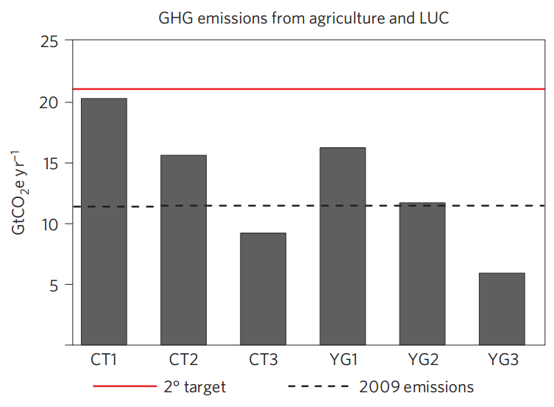
Agriculture is key for climate mitigation
BAU
Without drastic changes to agri-food systems, we will not be able to meet the 2°C target
  Under BAU, agriculture will emit 20.2 GtCO2e/yr, almost reaching 2°C target emission allowance for all sectors in 2050 (~21 GtCO2eyr-1)
  Food system transformation will be key for sufficient mitigation, e.g. yield gap closure, food waste reduction, and healthy diets (YG3 scenario)
2° target by 2050
2009 emissions from agriculture
CT1 = Current yield trend
CT2 = Current yield trend & 50% food waste reduction
CT3 = Current yield trend & 50% food waste reduction &
Healthy diets
YG1 = Yield gap closure (sustainable intensification)
YG2 = Yield gap closure & 50% food waste reduction
YG3 = Yield gap closure & 50% food waste reduction &
Healthy diets
Source: Bajželj et al. 2014

Slide 8
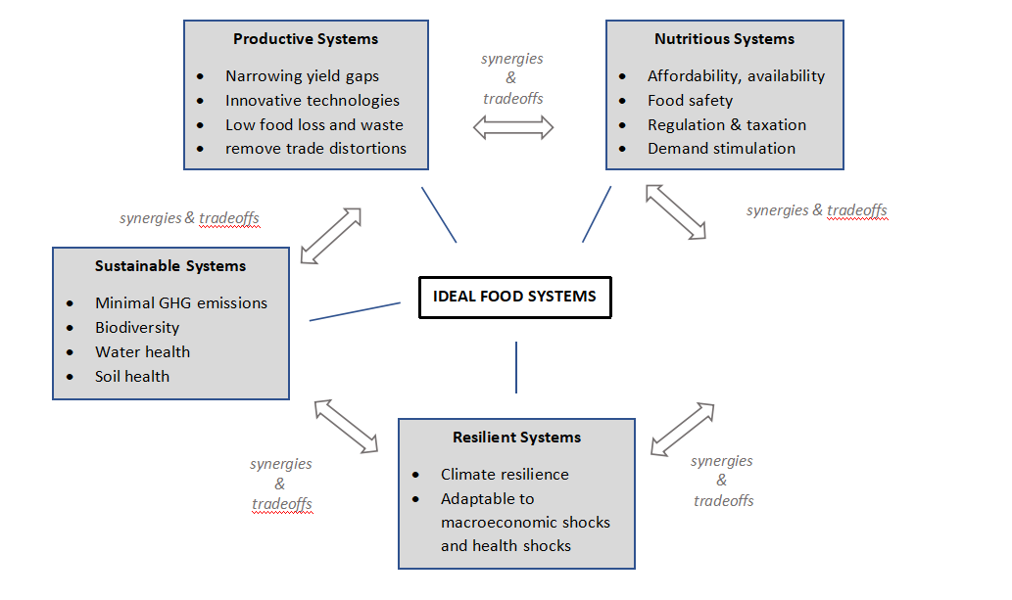
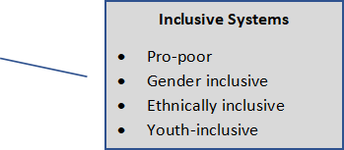
A food systems approach
A framework for evaluating trade-offs and synergies of food systems
for human and planetary health
Addressing global challenges require a multidisciplinary and food systems approach
A food systems approach must be used to identify, analyse and assess the impact and feedback of the systems different actors, activities and outcomes to help identify intervention points
Source: Fan, S., D Headey, C Rue, and T Thomas. 2021.Food Systems for Human and Planetary Health: Economic Perspectives and Challenges (Forthcoming). Annual Review of Resource Economics.

Slide 9
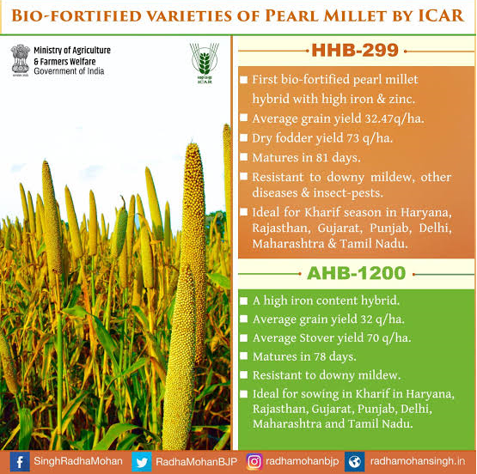
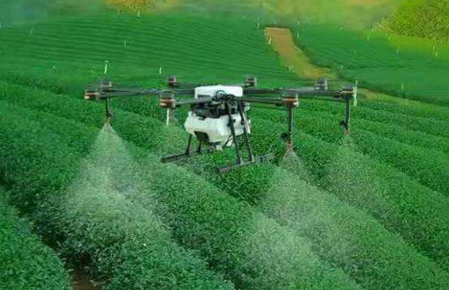

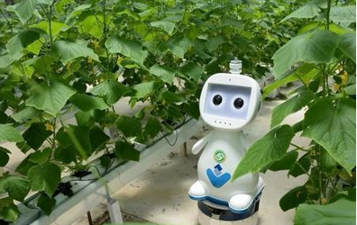
Multiple-win agricultural technologies
Biofortification
Multiple-win technologies
Yield increase, disease resistance and tolerance
Low carbon, water saving and environmental protection
Nutrition and health
  Vitamin- and mineral-rich crops grown and consumed in over 30 countries
  Girls and boys consuming biofortified pearl millet in India saw greater improvement in some cognitive performance (attention and memory) than those consuming non-fortified millet (Scott et al. 2018)
  More than 40 million smallholders and their families are already consuming biofortification foods
Precision agriculture
Digital agriculture
Artificial Intelligence Agriculture
Notes:
https://www.flickr.com/photos/icrisatimages/20564856401/in/gallery-156585242@N02-72157662081351518/
A farmer in Vietnam showing an improved variety of groundnut.
https://www.ncbi.nlm.nih.gov/pmc/articles/PMC4807965/
https://www.ncbi.nlm.nih.gov/pubmed/21682287

Slide 10

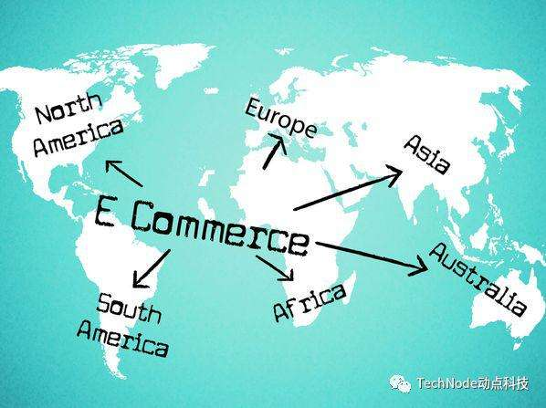
Embracing non-agricultural technologies
Technology-Use ICTs to improve food safety and value chains
Mobile phones, internet tracking for better accuracy, comprehensiveness
Novel foods
Alternative proteins to reduce health risks, GHGs, environmental impact
Case of China: Using e-Commerce
G20 initiative: Connects rural farmers with supply and demand information on agricultural produce and materials, and consumer products
Taobao Villages use e-commerce to foster entrepreneurship and create flexible, inclusive employment opportunities
Production of cultured meat involves up to 96% lower GHG emissions and water use, and 99% lower land use depending on conventional meat product compared (Thottathil, Jayasekaran, and Othman 2016; Toumisto 2011)
E-Commerce
Notes:
https://www.ncbi.nlm.nih.gov/pmc/articles/PMC4807965/
https://www.ncbi.nlm.nih.gov/pubmed/21682287

Slide 11
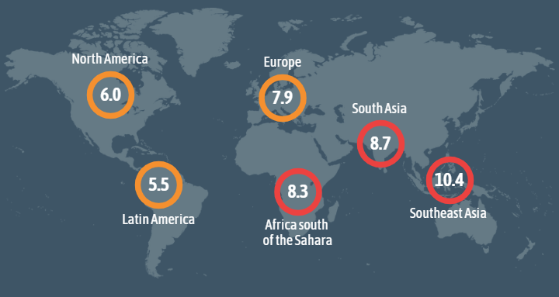

Reforming subsidy and support policies
Reform agricultural subsidies to support production of healthy and nutritious foods
Increase investment in value chains to improve access to healthy foods
Support production of healthy foods
Prices of nutrient-dense foods rising faster than energy-dense, nutrient-poor foods (Dizon and Herforth 2018)
EAT-Lancet reference diet is not affordable for the world’s poor—cost of diet exceeded HH per capita income for 1.58 billion people (Hirvonen et al. 2019)
Invest in rural roads and market facilities, as well as innovative rural finance to support agro-industries and rural food transformation and service industries
Relative caloric prices (RCPs) compared to cheapest staple foods by region
Source: Headey 2019
Notes:
Kumar et al 2016: https://ageconsearch.umn.edu/bitstream/253163/2/2-Anjani-Kumar.pdf
Headey, Hirvonen, and Hoddinott 2018: http://www.ifpri.org/publication/animal-sourced-foods-asf-and-child-stunting
Dizon and Herforth 2018: http://documents.worldbank.org/curated/en/382091534429994437/pdf/WPS8557.pdf
Headey 2019: http://www.ifpri.org/publication/relative-caloric-prices-healthy-and-unhealthy-foods-differ-systematically-across-income

Slide 12
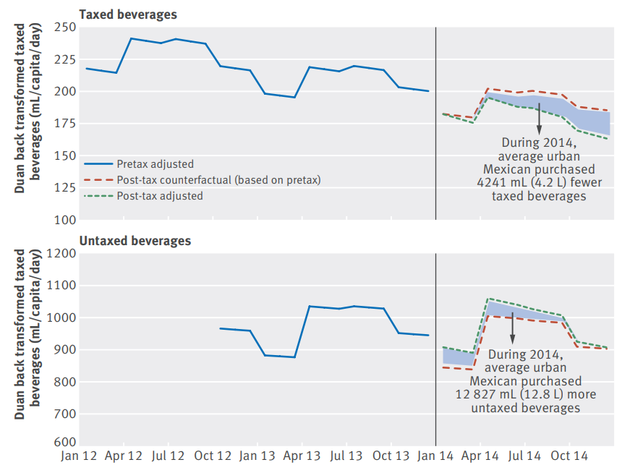
Reforming fiscal policies
Tax carbon-intensive and nutrient-poor foods
Tax emissions-intensive foods (e.g. meat and dairy)
Avoid more than 100,000 deaths in 2020 from reduced dietary and weight-related risk factors (Springmann et al. 2016)
Tax nutrient-poor foods – e.g. Mexico’s sugar sweetened beverage tax
SSB purchase declined by 6% on average
9% decline for lower social economic status households
Enhance nutrition-targeted social protection
Combining transfer programs with behavior change
communication（BCC) can improve child nutrition
In Bangladesh, cash transfers accompanied by high-quality BCC improved
children’s consumption of multiple-micronutrient powders or iron supplements in the last week by 22 percentage pts (Hoddinott et al. 2018)
BUT requires complementary policies and programs to link knowledge and behavior (Kramer 2017, Menon et al. 2017)
Impact of SSB tax in Mexico
Source: Colchero et al. 2016
Notes:
Springmann et al. 2016: https://www.nature.com/articles/nclimate3155
Hoddinott et al. 2018: https://www.cambridge.org/core/services/aop-cambridge-core/content/view/1E8022AF54A6C6EB21801B61FCD9C54C/S1368980017004232a.pdf/randomized_control_trials_demonstrate_that_nutritionsensitive_social_protection_interventions_increase_the_use_of_multiplemicronutrient_powders_and_iron_supplements_in_rural_preschool_bangladeshi_children.pdf
Kramer 2017: https://www.ifpri.org/publication/cooking-contests-healthier-recipes-impacts-nutrition-knowledge-and-behaviors-Bangladesh
Menon et al. 2017: https://www.fasebj.org/doi/abs/10.1096/fasebj.31.1_supplement.165.6
Colchero et al 2016: https://www.bmj.com/content/352/bmj.h6704

Slide 13
Enhance cross-sectoral coordination
In order to transform and reshape agrifood systems for global benefits, stakeholders will be required to undertake unprecedented collective action based on a solid understanding of the political economy in the agrifood system at the local, national, and global levels.
To facilitate such an approach, we must establish formal and informal collaborative interactions and structures among governing groups, including various UN bodies and specialized agencies, to focus on cross-sectoral issues like healthy and sustainable diets.
Relevant sectors and ministries at the national level, such as ministries of food,health, agriculture, and environment, will need to coordinate their efforts.
Food
Agriculture
Environment
health
Photo: USAID
Notes:
Photo; USAID-Tanzania https://www.flickr.com/photos/usaid_images/5842086033/in/photolist-ovvDBA-oNHtu6-cVqUUm-oJatX8-owtGFr-bz3qYo-bvpXzQ-ejrHs6-ovzxWM-cVqV83-9UfdDg-9UfdAM-oRvKaz-8SmNDo-oqLcLW-oPLkqi-cVqWQC-9EfBhR-bJjL2H-aviThY-bhgH76-bJjKVg-gK4xFh-pj3hk8-oFmDXh-bvpXx7-oHyNS3-cVqVRW-9Ufdyn-orSTj4-or6YMa-fV7Ltm-ejxr6C-bvpXN7-bvpXKQ-ayZ2cG-bMX6Gr-bhgH9v-yDQE2S-utomRL-tyFSDy

