Slide 1
Transforming Global Food Systems
After Covid-19
Johan Swinnen
International Food Policy Research Institute
10th ASAE International Conference
“Gearing Asian Agriculture Under the 4th Industrial Revolution”
December 7, 2021

Slide 2
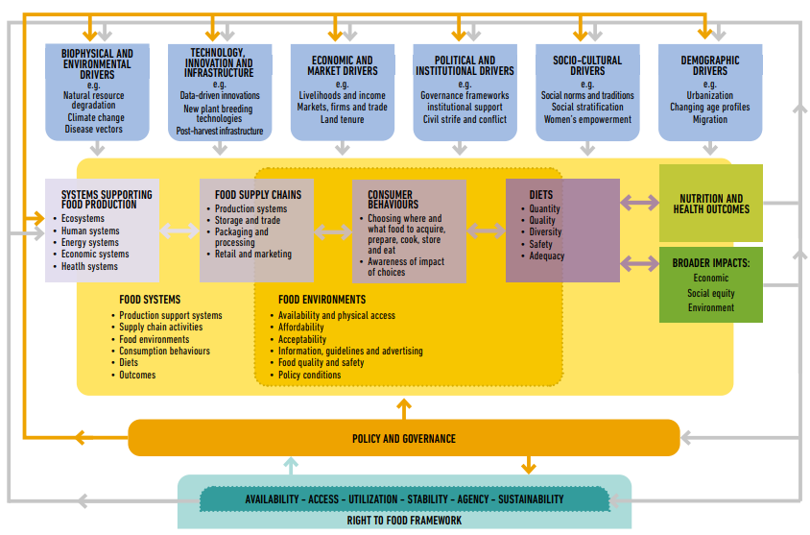
CFS : Sustainable Food Systems Framework
Source: CFS, 2021

Slide 3
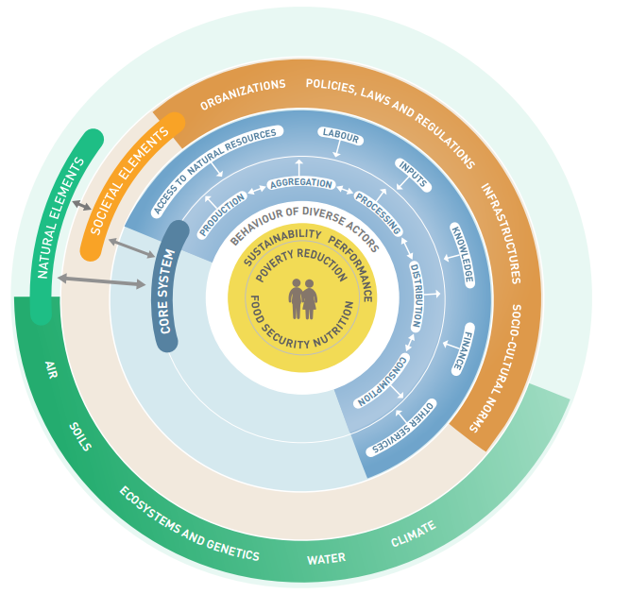
FAO: Food Systems
Source: FAO, 2018

Slide 4
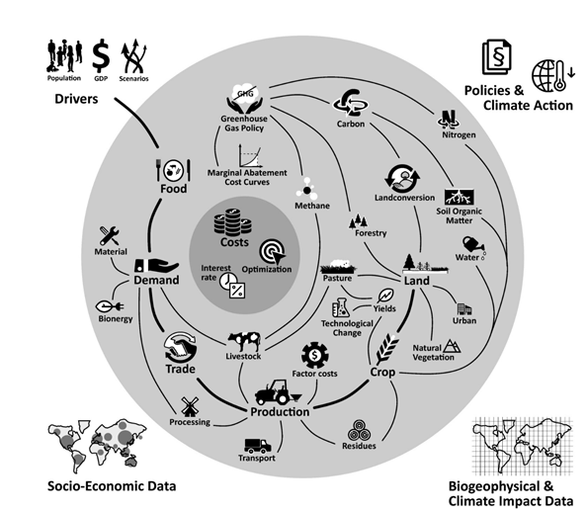
FSEC: Food Systems
Source: Food System Economic Commissions website

Slide 5
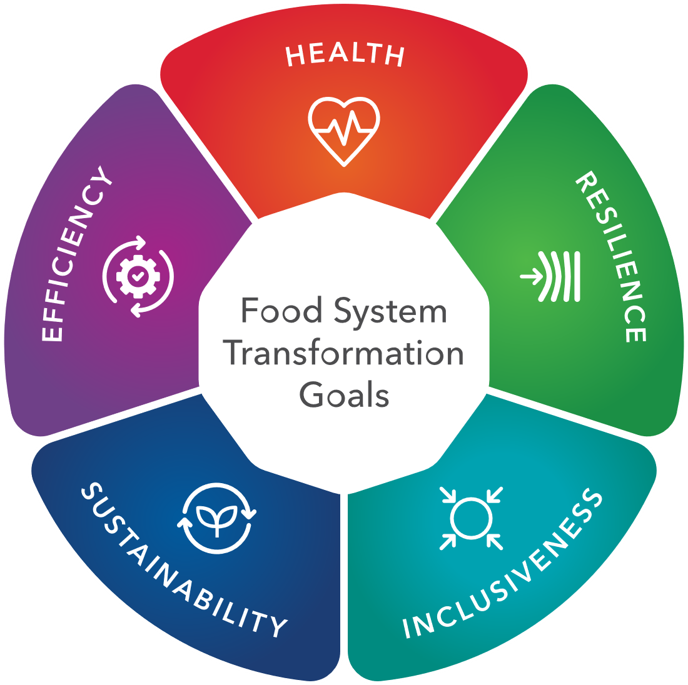
Transformation of Food Systems :
Goals and Value Chains
Source: IFPRI Global Food Policy Report 2021; Swinnen et al 2015

Slide 6
Economic growth and food security
Prevalence and number of undernourished worldwide
GDP growth per capita (annual %)
Source: FAO 2020
Source: World Bank 2020
Notes:
Data from database: World Development Indicators

Slide 7
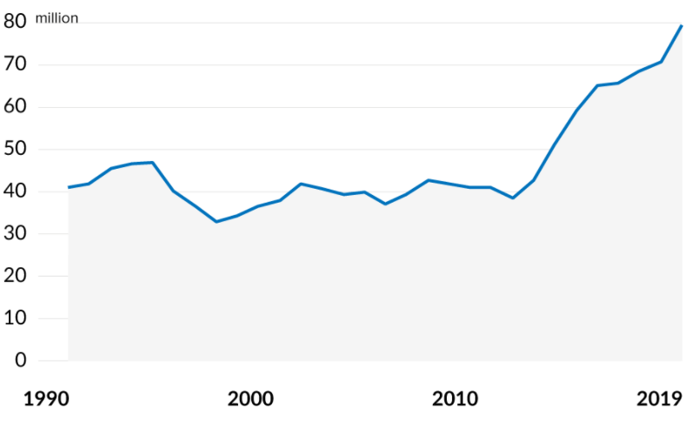
Conflict and food security
Prevalence and number of undernourished worldwide
Forcibly displaced people worldwide
Source: FAO 2020
Source: UNHCR 2019, 2020
Notes:
Data from database: World Development Indicators

Slide 8
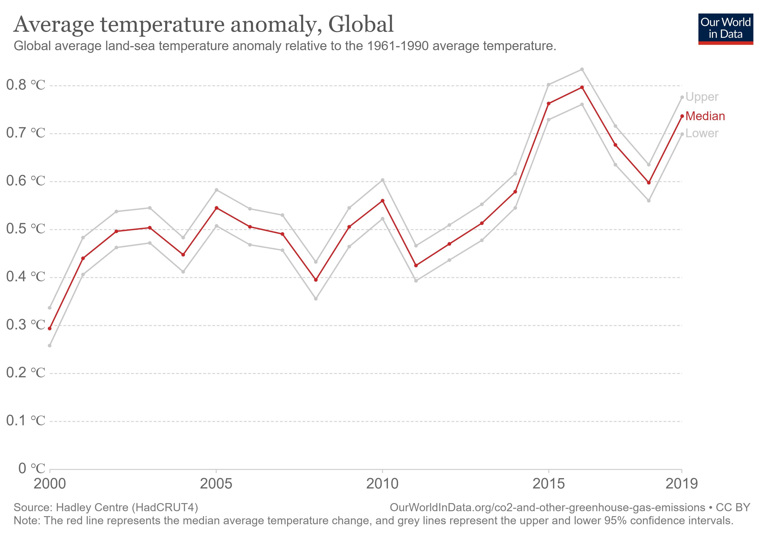
Climate change and food security
Prevalence and number of undernourished worldwide
Average global temperature anomaly
Source: FAO 2020
Source: Our World in Data-Hadley Centre 2020
Notes:
Data from database: World Development Indicators
https://ourworldindata.org/grapher/temperature-anomaly?time=2000..latest

Slide 9
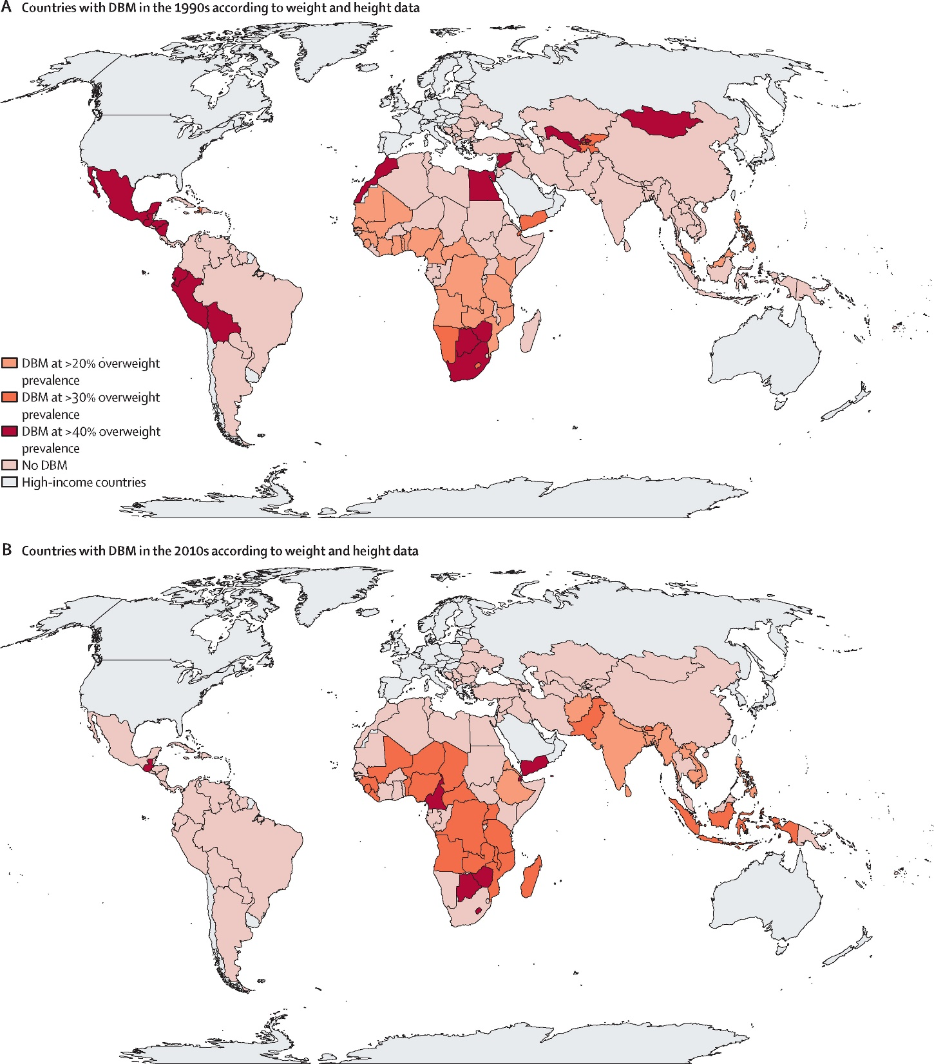
Triple burden of malnutrition
Coexistence of undernutrition (wasting and stunting), micronutrient deficiencies, and overweight and obesity
Countries with undernutrition and overweight and obesity, 2010
  3 billion people cannot afford a healthy diet
  2 billion people with micronutrient deficiencies
Source: Popkin et al. 2020
Source: Ruel 2019, Leroy 2019, Van Wesenbeeck et al. 2018
Notes:
Triple burden of malnutrition at the country level was defined as a high prevalence of undernutrition (wasting and stunting in children aged 0–4 years, and thinness in adult women), micronutrient deficiencies, and overweight and obesity (defined according to three different overweight prevalence thresholds: 20%, 30%, and 40%) in at least one population group. https://www.sciencedirect.com/science/article/pii/S0140673619324973#fig1

Slide 10
Undernourishment and Overweight in Asia
Prevalence of undernourishment (percent)
Prevalence of overweight in children under 5 (percent)
Source: FAO Stat
Source: Ruel 2019, Leroy 2019, Van Wesenbeeck et al. 2018
Notes:
Triple burden of malnutrition at the country level was defined as a high prevalence of undernutrition (wasting and stunting in children aged 0–4 years, and thinness in adult women), micronutrient deficiencies, and overweight and obesity (defined according to three different overweight prevalence thresholds: 20%, 30%, and 40%) in at least one population group. https://www.sciencedirect.com/science/article/pii/S0140673619324973#fig1

Slide 11
Food systems pressure planetary boundaries
The global food system consumes >30% of global energy and >20% of global GHG emissions
… it also contributes to increased water stress and scarcity, affecting production in large parts of the world
Climate change is reinforcing these pressures.
Source: EAT-Lancet Report 2019

Slide 12
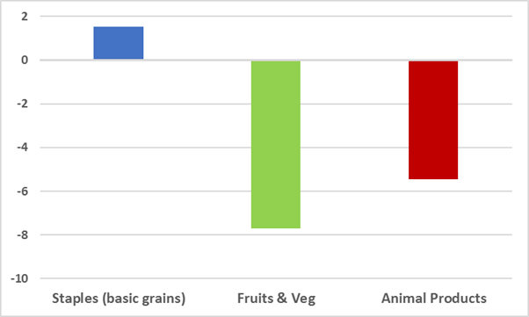
COVID-19 impacts on global poverty and nutrition
Impact on Global POVERTY
Impact on Global NUTRITION
Source: Laborde, Martin and Vos, 2020
Notes:
Demand fallout: (i) impact on food access (refer to income impacts and poverty effects from our global scenario analysis)

Slide 13
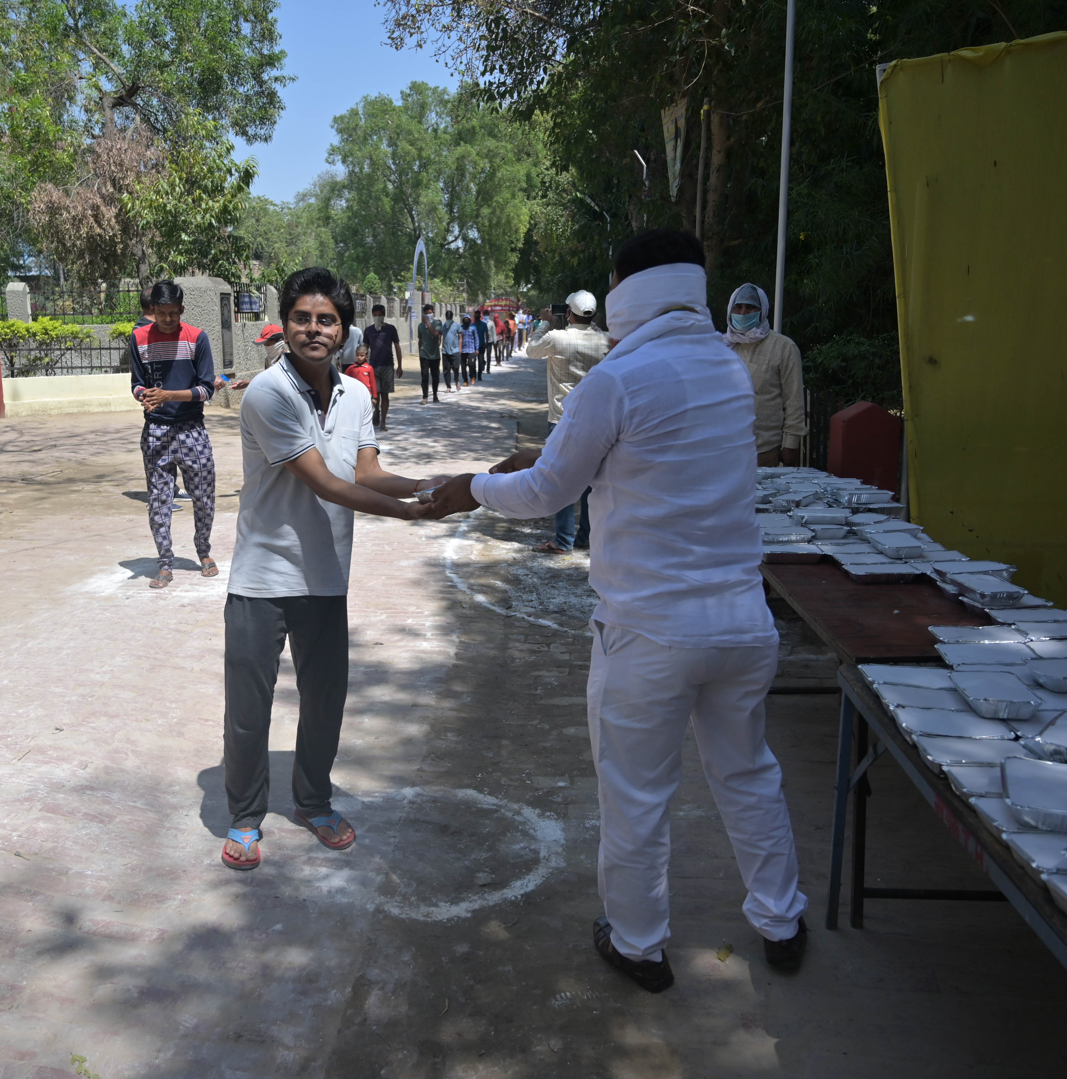
Poor people’s food and nutrition security is disproportionately affected by COVID-19
They spend a large share of their income on food
Their main production factor and asset is physical labor
COVID causes more disruptions in their (private) food value chains – since more labor-intensive
Public social and nutrition programs are disrupted (more important for them)
Less access to health services
Especially vulnerable: children, women,
(ex-)migrants

Slide 14
COVID-19 impacts on inequality in food systems
Survey results from Ethiopia
Poor people suffer more
from INCOME declines
Poor people suffer more from
NUTRITION effects
% of households that have much lower incomes
% of households consuming dairy products
Source: Hirvonen et al. 2020; Tesfaye et al. 2020.

Slide 15
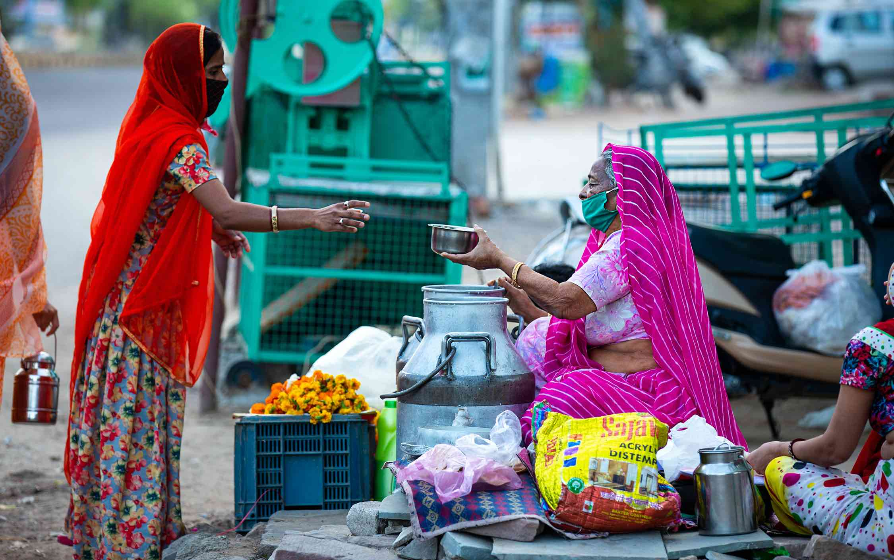
Women are especially vulnerable
Gendered impacts of COVID-19
Health measures affect women and men differently in developing countries, particularly in rural areas
Income shocks also have gendered impacts
  Impact on women’s empowerment and children’s schooling could affect female labor force participation in the next generation, also violence-related services
Gender-sensitive policy responses
Adapt existing policies and social protection to account for gender implications
Improve program targeting for women
Utilize accessible delivery mechanisms
Complementary programming in food and nutrition, water and sanitation, maternal health, etc.
Source: Quisumbing et al. 2020; Hidrobo et al. 2020.

Slide 16
Income declines and gender effects of COVID-19
Impact of fall in remittances in Myanmar
Income decline (%) due to a 50% international remittance shock and a 30% domestic remittance shock among poor households
Source: Diao and Wang 2020
Notes:
Chapter 13: Significant economic impacts due to COVID-19 and falling remittances in Myanmar

Slide 17
COVID-19 and Public Services and Food Programs
Changes in Service Utilization Among Mothers in Uttar Pradesh (India)
Source: Diao and Wang 2020
Notes:
Chapter 13: Significant economic impacts due to COVID-19 and falling remittances in Myanmar

Slide 18
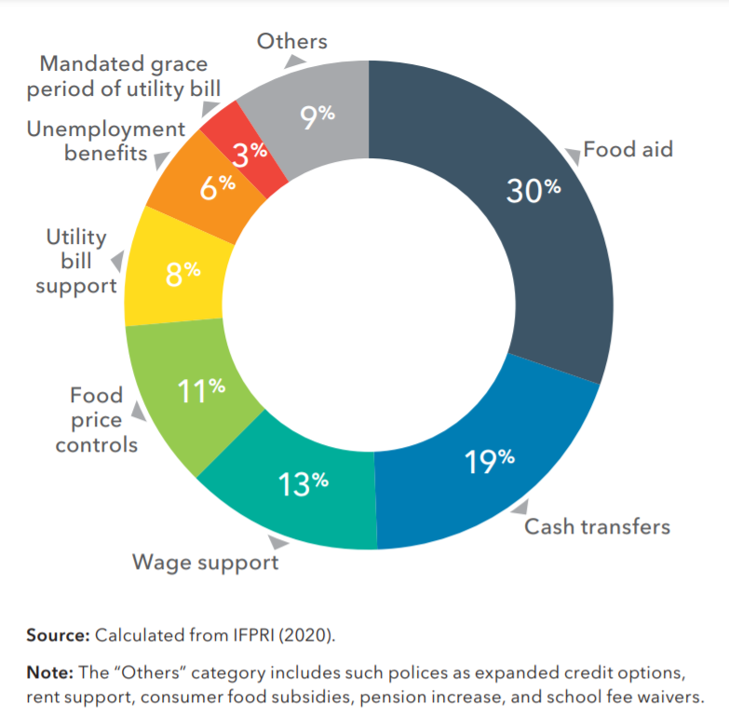
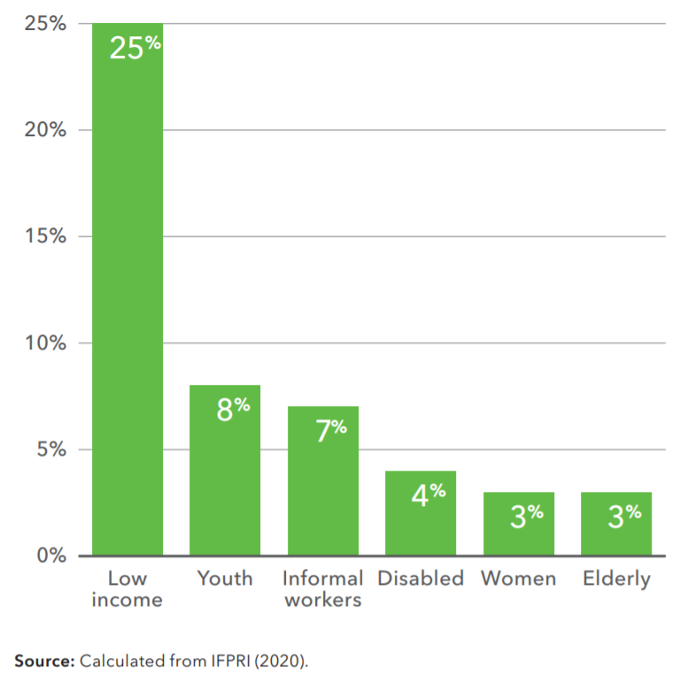
Scaling and sustaining social protection under COVID-19
Distribution of policy types within social protection
Share of social protection policies targeted to specific populations
Source: Fang, Kennedy, and Resnick, 2020.
Notes:
Chapter 14: COVID-19: Trade restrictions are worst possible response to safeguard food security
The Chinese government implemented numerous social protection programs such as tax reductions, rent relief, and direct financial support.
However, the reach of these programs was limited. R Small farmers and self-employed businesses often did not qualify for support. Whils 1.5 trillion yuan ($223 billion) of support was offered to SMEs, only 15% of SME’s reported accessing this aid. This number was only 9% for self-employed businesses.

Slide 19
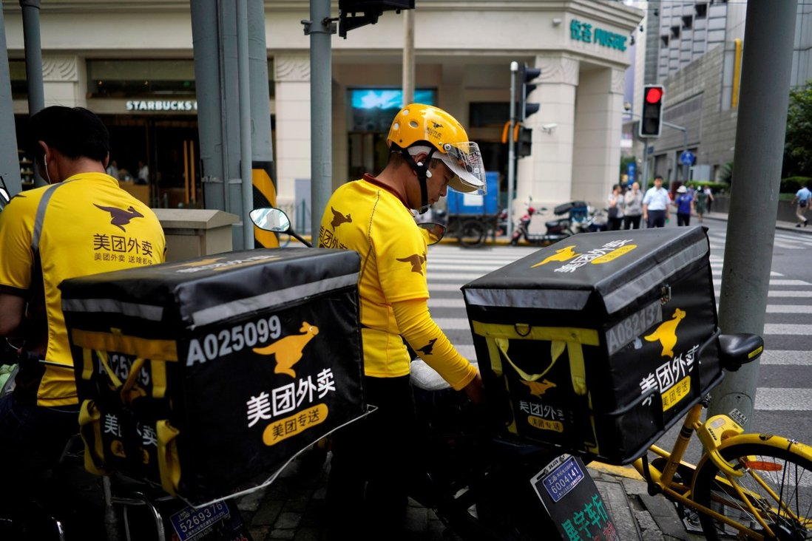

Restructuring supply chains and food systems
Heterogeneity:
  Global -- local
  Labor -- capital intensity
  Large -- small-scale
  Short -- long run
  Staples -- perishables
Many innovations to overcome restrictions
  E.g. Digital growth :
  e-commerce & ICT solutions like FoodPanda
  Cloud Kitchens, Meituan
Source: Reuters, 2020.
Source: Reardon and Swinnen, 2020.
Notes:
The food delivery market in South East Asia is expected to grow by $2 billion between 2018-2025 (ASEAN Post 2020)

Slide 20
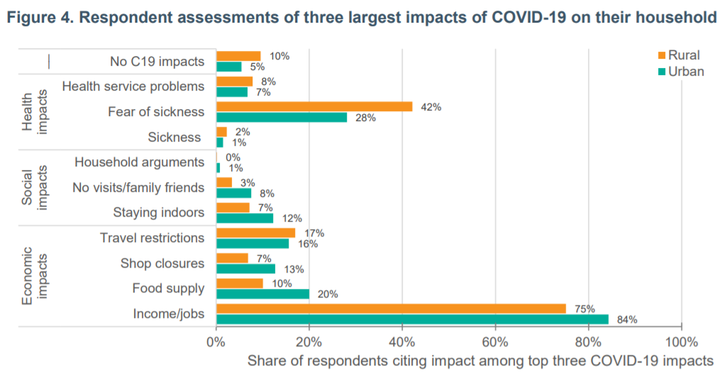
Supply disruptions versus income and employment
Survey evidence from Myanmar
Despite disruptions, food supply chains adjusted relatively well to meet demand
Household income and job loss were most severe impact
Source: IFPRI and MSU, 2020
Notes:
Chapter 15: COVID-19 border policies create problems for African trade and economic pain for communities

Slide 21
COVID-19 impacts : Rural vs Urban
Increase in Poverty
(% points – average per month of lockdown)
Atul Loke / Panos Pictures
Source: Amewu et al. 2020; Baulch et al. 2020; Diao et al. 2020; Pradesha et al. 2020; Thurlow, 2020.

Slide 22
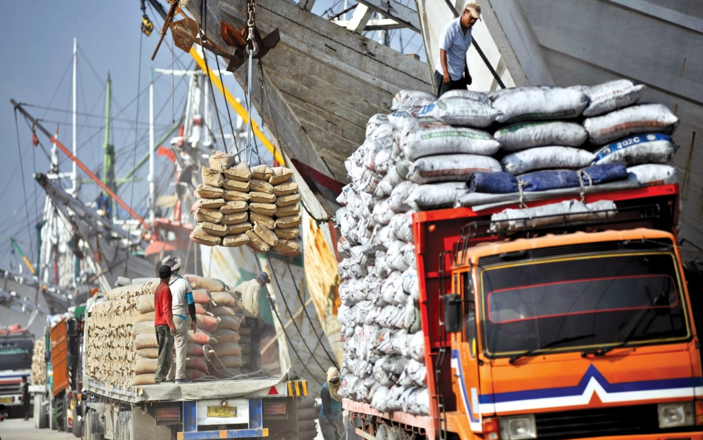
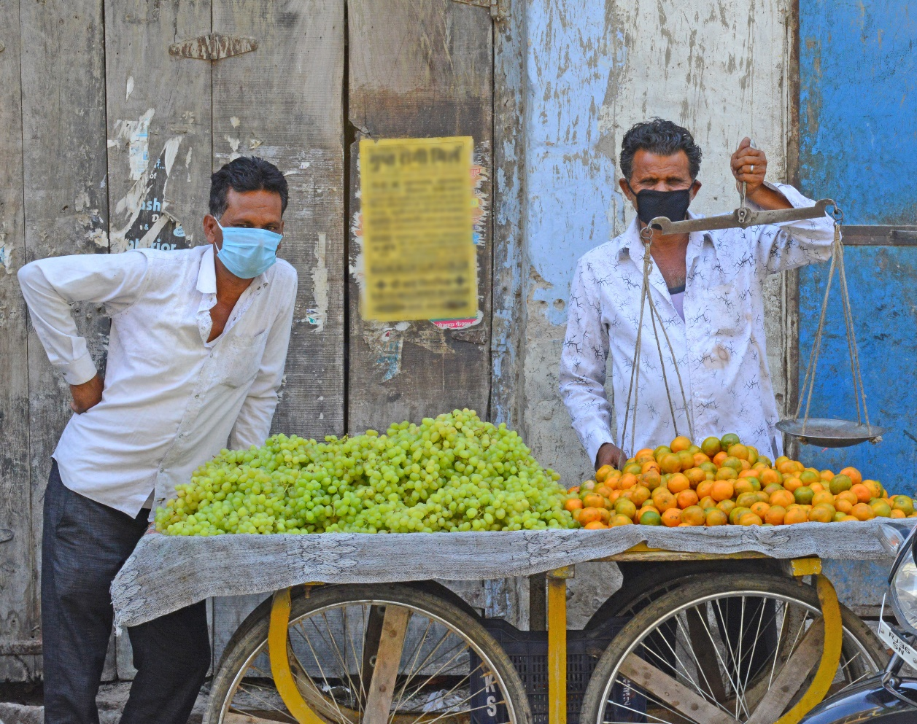
Trade is crucial for food security
and for dealing with shocks and climate change
Food and trade policies
need to support
rather than hamper
Source: Gouel and Laborde 2018
Notes:
https://www.nber.org/papers/w25221
Market adaptations rely significantly on an international trade system allowing large reallocations of trade flows
a rule-based trading system will be needed to enable climate change adaptation
*figure: GAEZ project. Baseline: 2011 market share. For the yields under climate change,
we adopt a 2080s horizon, corresponding to an average of the years 2071–2100, a climate simulated by the UK Met
Office Hadley Centre coupled model under the emission scenario A1FI.

Slide 23
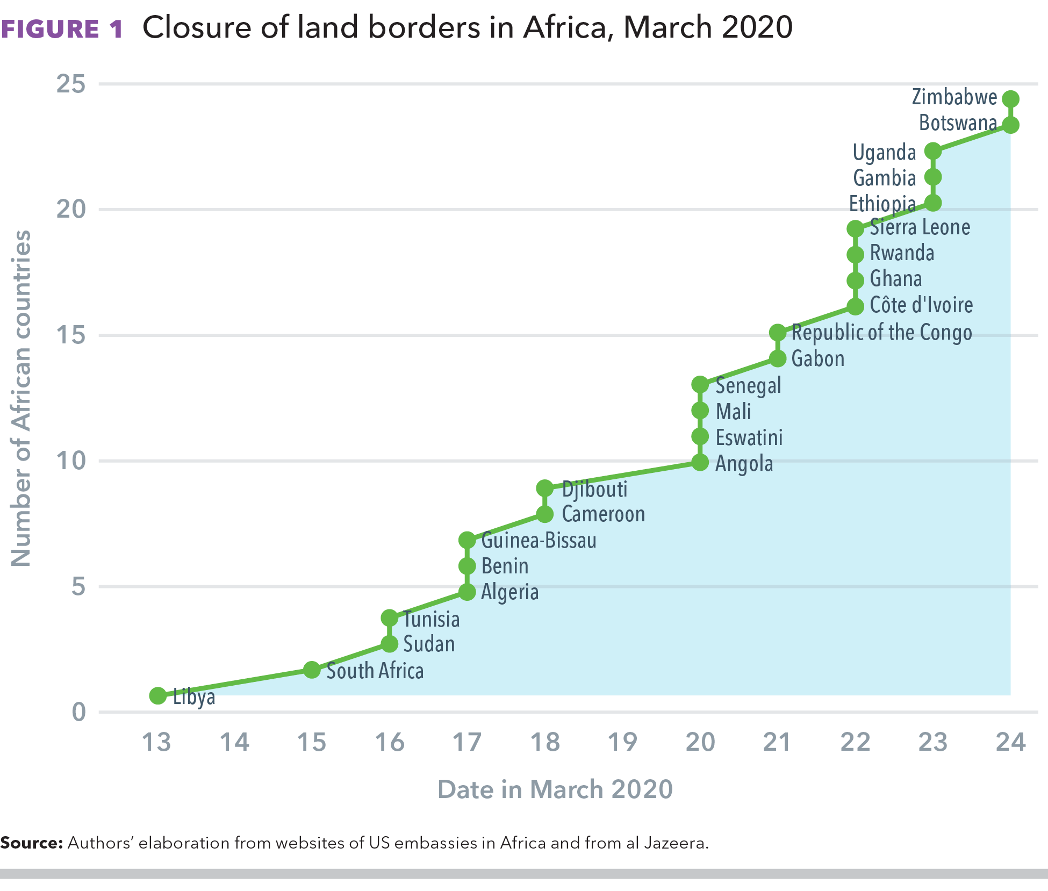
COVID-19 trade restrictions (int’l and domestic) create problems for developing countries
Rapid response to export restrictions by major global producers: “Trade restrictions are worst possible response to safeguard food security”
  FAO, G20, WTO etc., called for open trade to avoid repeating the problems of 2007-2008—skyrocketing world prices
Developing country responses vary widely in approach and impact
But trade restrictions very widely applied
See: IFPRI’s COVID-19 Policy Response Portal
Source: Bouet and Laborde, 2020; Resnick 2020
Notes:
Chapter 15: COVID-19 border policies create problems for African trade and economic pain for communities

Slide 24
“Repurposing” agricultural subsidies
and trade policy – food system effects
Agric Producer Support (PSE) in Asia
(% of Gross Farm Receipts)
Annual global agricultural supports currently amount to over $700 billion
Most of these subsidies are market distorting and fail to encourage healthy and sustainable food systems
Source: OECD

Slide 25
“Repurposing” agricultural subsidies
and trade policy – food system effects
National real income
National real income
Real farm income per workers
Real farm income per workers
Poverty rate reduction
Poverty rate reduction
Healthy food prices reduction
Healthy food prices reduction
Emissions reduction
Emissions reduction
Agricultural land reduction
Agricultural land reduction
Source: IFPRI and World Bank (2021)
Notes:
“A small share” is approximated 1% of agricultural GDP (or about six percent of current support)
As the worlds largest agricultural market China can lead the world in subsidy reform.
The loss to the farm sector is a loss to fixed factors in the sector associated with declines in farm price brought about by higher productivity.
Real returns to labor in the sector are increasing, and the fall in food prices is helping poor consumers.
The key message is that we have to go bold if we want to make a big difference to outcomes.

Slide 26
Transforming food systems will require a combinations of behavior changes, innovations, technologies and policy responses
Examining the impacts of different mitigation strategies
Adaptation of diets -- transition away from meat consumption is needed to address GHG emissions
Technology and improved resource management and reduce waste are most effective at addressing land and water use
Policy reforms -- a combinations of regulatory measures and incentives reduce impacts below current levels
Effects of different mitigation policies relative to projected environmental impact in 2050 on three environmental domains
Source: Springmann et al. 2018.
Notes:
The figure shows that changing diets to fit with
Reducing food loss by ½ (dark orange bar) or 75% dark and light orange bar) would have a larger impact on water and land use since most losses are from crops instead of animal based foods.
Technology changes include better management of water, fertilizer, land, manure and other resources as well as improved crop varieties. Most improvements from technology would come from staple crop production where technology would has limited potential to improve livestock production due to inherent characteristics of raising animals.
Changes in diets involves a transition in line with global dietary guidelines. Most of the benefits of this transition to GHGs come from reduced meat consumption.

Slide 27


A Transformative Moment for Food Systems ?
Much creativity and innovation in restructuring value chains and food systems and policy
From crisis management to opportunity to create more resilient and more sustainable and more inclusive food systems
Use the opportunity of economic recovery and of the 2021 Global Summits
Crucial role to play for public
and private sectors
GDP Growth in Asia (%)
Notes:
The Summit provided a precious opportunity to agree on a common program for environmental health, food security, and social well-being.

