Slide 1
Emerging Institutions in Agriculture for Incentivizing Smallholders in India
P K Joshi
President
Agricultural Economics Research Association (India)
E-mail: pkj.in@outlook.com
Plenary lecture in the Asian Society of Agricultural Economics on 7 Dec 2021, Beijing, Chiana

Slide 2
India sets targets for economy and agriculture
Five trillion-dollar economy by 2024-25 and ten trillion-dollar by 2030
  From US$ 2.7 trillion in 2020
Doubling farmers’ income by 2022
  US$ 1800/year in 2016-17 to US$ 3600/year
  Increase productivity, reduce cost, remunerative prices, agricultural diversification, value addition and explore non-farm opportunities
Self-reliant (Aatma Nirbhar) India
  Reduce import, push for import substitution and increase exports
Local for Global
  Niche commodities from different agro-ecoregions for global markets

Slide 3
Dominance of smallholders
Total holdings increased from 71 m in 1970-71 to 146 m in 2015-16
Operated area declined from 162 m in 1970-71 to 158 m in 2015-16.
86% holdings are small in 2015-16 (125 m); 70% in 1970-71 (50 m)
Average size of holding declined from 2.28 in 1970-71 to 1.08 ha in 2015-16
  Marginal farmer (<1 ha): 0.38 ha

Slide 4
Key challenges of smallholders
Disadvantage of economies-of-scale
Inadequate access to information and technologies
  Low adoption of improved technologies
  High lag in adoption of improved technologies
Poor access to services and input/output markets
  High transactions costs
  Poor business skills
Tiny marketable surplus; low bargaining power
High indebtedness (41% in rural areas, majority smallholders)
  Majority credit from informal sector (largely moneylenders)
Highly vulnerable to climate change

Slide 5
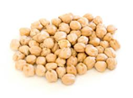

Low share in consumer prices due to long supply chain
Farmer
Consolidator
or local trader
Trader
Commission
Agent
Consumer
Retailer
Processor
Wholesaler
Unorganized, fragmented and inefficient
Low processing and poor food safety concerns

Slide 6
Promoting Collectives

Slide 7
Need to aggregate farmers: benefits of collectives
Reduce cost of production by procuring inputs in bulk at wholesale prices
Aggregation of produce and bulk transport reduces marketing cost
Attracts traders to collect produce at farm gate
Easy in communication for dissemination of information about prices, volume and other farming related advisories
Access to financial resources against the stock without collaterals
Improved bargaining power and social capital building

Slide 8
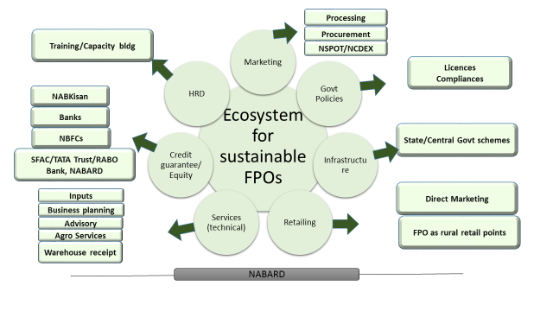
Ecosystem for sustainable Farmer Producer Organization
(NABARD, 2019-20)

Slide 9
Farmer Producer Organizations (FPOs)
Formation and Promotion of 10,000 FPOs
Budget outlay: US$ 930 million
Cluster approach
  One district – One product
  Promote specialization
Better connected with input and output markets
Lower information & input cost
Role of middlemen reduced

Slide 10
Challenges in forming and implementing FPOs
Inadequate awareness about benefits of FPOs
Heterogeneity of farmers discourage to come together
  Size of holding, caste, religion
  Political affiliation
Dissimilar resources, soil and water
Lack of technical and legal knowledge of various Acts
Poor forward linkages
Non-availability of competent authority for hand-holding

Slide 11
Contract framing: what attract smallholders?
Assured prices and procurement
Higher profit
  Access to better technology and lower transaction costs
More gains to smallholders than the large farmers
Farmers receive higher prices
  5-20% higher in vegetables (SAFAL case study in India)
  25% higher in broiler (Venkateshwara Hatcheries case study)
  4% higher in milk (Nestle case study in India)
Risk is shared
  As high as 88% risk is shifted by producers to the firm

Slide 12
Problems in Contract Farming and Conditions for Success
Low marketable surplus and heterogenous product
Breach of contract
  Producer or the firm
Low bargaining power of smallholders
  Low volume
Asset specialization
  Restricts change in production portfolio
Dependency on the firm in the long-run
  Access to market, information and technology

Slide 13
Financial Instruments

Slide 14
Kisan (Farmer) Credit Card (KCC)
Launched in 1998 and upgraded in 2018
  18 million cards sanctioned
  US$ 25 billion as cash, crop, consumption and term loan
  Collateral free loan up to US$ 2300
Hassel free and timely credit
Farmer is insured (death and disability)
  Premium paid: bank & farmer (2:1)
Impact of Crop Insurance Scheme (IFPRI: Anjani et al 2021)
  Reduces dependences on moneylenders by 25%
  KCC farmers attained higher income
  Only 43% farmers have active Kisan Credit Card

Slide 15
Agricultural Insurance Scheme
PM Crop Insurance Scheme (PMFBY)
Objectives
  Provide insurance coverage to the farmers
    Natural calamities, pests & diseases.
  Stabilise farmers’ income and encourage to adopt improved practices.
Highly subsidized: premium paid by farmers range from 1.5 to 2%
  Budget allocated US$ 2000 million in 2021-22
Impact of crop insurance scheme (IFPRI: Anjani et al 2021)
  Increased risk bearing ability
  Used higher quantity of fertilizer and other inputs
  Adopted improved varieties
  Increased income of insured farmers

Slide 16
Direct Income Transfer
PM KISAN Scheme
Aim is to address the liquidity constraints of farmers for meeting their expenses for inputs and services.
  Approximately US$ 10 billion allocated in 2020-21
  Annually three instalments are released directly in farmers’ account
On-season release: 52% spent on agriculture, 26% on consumption, 7% on education & health, and remaining on other incidental expenses
Off-season release: 39% on consumption, 23% in agriculture; and rest in other
Impact was much higher when connected with extension services
  Complementarity between capital and knowledge

Slide 17
Technology dissemination and market-linked institutions

Slide 18
Agriculture Science Centers
Krishi Vigyan Kendras (KVKs)
Act as knowledge and resource centers of agricultural technologies
  Bridge between research organizations and main extension system
  Conduct farm demonstrations, organize capacity development programs and use ICT and other media means on varied subjects of interest to farmers
Every district has at least one KVK: 725 KVKs have been established
Impact of KVK (IFPRI: Anjani, et al 2018; Deepak, et al 2018)
  One-dollar investment in KVK generates approximately $8 gross returns
  Frontline demonstration: 3% of primary beneficiaries of FLDs can generate information spill-over to 31% of farmers.
  Capacity building: 3% of primary beneficiaries can generate information spill-over to 27% of farmers.

Slide 19
Post-harvest market linked institutions
One nation – One market (e-NAM: electronic National Agricultural markets)
  Pan India digital platform for agricultural marketing
  Digital platform to help farmers fetch best prices
  Reduce transaction costs of smallholders through digital trading
Price-deficiency mechanism (to reduce risk of price crash)
Warehouse receipts
Futures markets

Slide 20
Conclusions
Emerging institutions are playing important role in transforming agriculture
Aggregating smallholders to take advantage of emerging opportunities is a necessary condition
Success depends upon how the processes are developed and implemented
Government support is pre-condition for the success of the emerging institutions
Need for studies to understand small farmers’ behavior for engaging in emerging institutions

Slide 21
Thank you

