Slide 1


Repurposing Agricultural Policies and Support:
Options to Promote Sustainable Agricultural Development
Madhur Gautam*, David Laborde†, Abdullah Mamun†, Will Martin†, Valeria Piñeiro† & Rob Vos†
10th Asian Society of Agricultural Economists International Conference
7 December 2021
*World Bank, † IFPRI

Slide 2
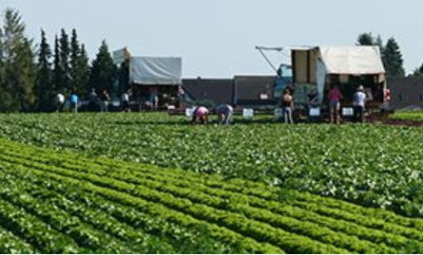

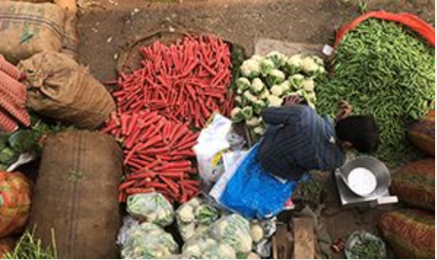
Global Policy Question
How can agricultural measures be repurposed to provide incentives for sustainable food system transformation?
  That is, to meet food security, poverty reduction, climate and other environmental sustainability goals

Slide 3
Background & Context

Slide 4
Remarkable progress in food production over past 60 years but strong headwinds emerging – hunger and malnutrition on the rise
Past growth driven by productivity, but with large hidden costs
Slowing growth and rising volatility in food production per capita
Source: Authors, using FAOSTAT
Notes:
Food demand is expected to continue to growth to 2050 when population is projected to reach 9.7 billion people and with rising incomes. These trends will come with a substantial increase in the demand for resource- and emission-intensive livestock products.
Agricultural land increased by only 8 percent, and land under crops by 16 percent, over the past 60 years. It has nevertheless pulled a substantial 357 million hectares into agriculture (216 million hectares for crop production and 115 million hectares as pastures for livestock production)

Slide 5
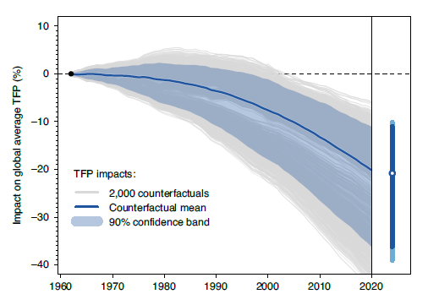
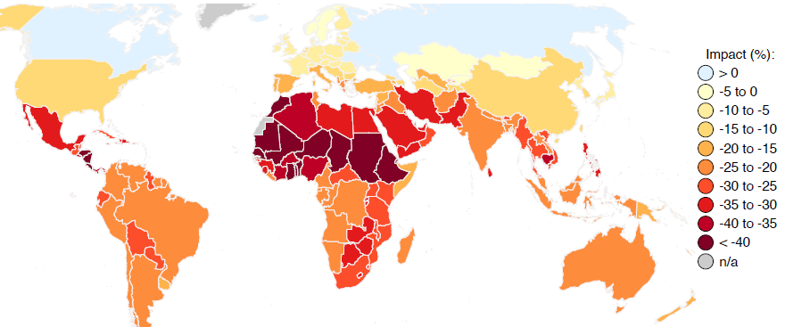
Climate change no longer a distant threat:
Impacts on agricultural productivity growth already being felt – and accelerating!
Source: Ortiz-Bobea, A., Ault, T.R., Carrillo, C.M., Chambers, R.G. and Lobell, D.B. (2021), ‘Anthropogenic climate change has slowed global agricultural productivity growth’ Nature Climate Change, 11: 306–312. http://www.nature.com/natureclimatechange

Slide 6
Core Issue: Incentives
Do current agricultural policies & support create the incentives to make agriculture more productive, sustainable and nutrition sensitive?
Total support to agriculture by 79 Countries
(Annual average 2016-2018, billions of current US$)
Nature and level of support varies widely across countries
(Annual average 2016-2018, billions of current US$)
Source: Authors using data from IO Consortium on Ag-Incentives (IFPRI, OECD, FAO, IDB, and World Bank)

Slide 7
Agricultural Emissions are Highly Concentrated, %

Slide 8
Agricultural Emissions are Process Emissions
Changes in support rates do not usually change the production process
  With some exceptions such as fertilizer subsidies
In contrast with emissions from combustion
  Where carbon taxes cause shifts in the production process used
    eg away from burning coal to burning gas, or from gas to renewables
  And fuel subsidies encourage use of polluting fuels
Most subsidy reforms influence emissions only by changing outputs

Slide 9
Methodology

Slide 10
Research Methodology
Develop a global database of agricultural subsidies & trade barriers
  OECD, FAO-MAFAP, IADB, World Bank, curated by IFPRI in Ag Incentives Consortium
Database and model of emissions by commodity and by source
Model incorporates emissions from production & land use change
  Builds on the MIRAGRODEP global CGE model
  Emissions from production respond to changes in output & production practices
  Emissions from land use change respond to economic incentives
  Policies change 2020-5 and impacts measured against 2040 reference simulation
Evaluate impacts on multiple goals
  Emissions, economic, farm, poverty, diets, nature

Slide 11
Study question: Options for Repurposing Current Policies and Support
To deliver better economic, environmental, social, nutrition and climate outcomes
Use IFPRI’s global dynamic general equilibrium model (MIRAGRODEP) to simulate outcomes to 2040
Baseline projections: business as usual
Source of emissions growth

Slide 12
The Range of Policy Options Considered
Is support the problem?
  Remove all domestic support, ie budget support
  Remove all domestic & market price support
Can we improve by reallocating support?
  Perhaps peak levels of support are the problem?
    Shift to uniform support across all products
  Is Support to CO₂ intensive commodities the problem?
    Move support to non-CO₂ intensive commodities
Can we change the technology to reduce emissions?
  Conditionality – make support conditional on reducing emissions
    eg emission intensity and TFP fall by 10%
  Green Technology to raise productivity, reduce production & LUC emissions
    eg emission intensity down 30%, productivity up 30%

Slide 13
Results

Slide 14
Removal of domestic support:
Some desired outcomes but also important tradeoffs
Impact on emissions, mt CO₂: different forms of support
Broader impacts of removing all domestic support

Slide 15
Options for Repurposing Policies and Support:
Some desired outcomes but also important tradeoffs
Policy options
Removal of support:
Remove all dom. support
Remove all domestic and market price support
Repurposing of support:
Shift to uniform support across all products
Shift to support of CO₂ efficient products
Conditionality – make support conditional on reducing emissions
Focus on emission-efficient productivity

Slide 16
Removing subsidies vs Repurposing for Productivity & Emission Reductions
National real income
National real income
Real farm income per workers
Real farm income per workers
Poverty rate reduction
Poverty rate reduction
Healthy food prices reduction
Healthy food prices reduction
Emissions reduction
Emissions reduction
Agricultural land reduction
Agricultural land reduction

Slide 17
Conclusions
Traditional (naïve) recommendation to simply remove or abolish support has mixed outcomes
  Improves economic efficiency, reduces GHG emissions
  But at a cost: lower farm output and higher cost of healthy diets.
Aggregate impacts on emissions at global level are modest
  Domestic production replaced by imports. Eliminating Market Price Support raises global demand
  Overall decline in output relatively small – raises the question of the value for money for the billions currently being spent on producer support
Conditioning support on environmental outcomes also faces a similar dilemma
  Reduces GHGs, but reduces productivity, needs more land; raises cost of healthy foods
Clear message: repurpose support towards productivity enhancing investments
  Repurposing support towards investments to raise productivity has large triple-win payoffs
  Biggest “bang for the buck”: repurpose to investments in emission efficient technologies/practices
Caveat: Labor market rigidities would result in declining incomes per farm worker
  Invest in human capital development and skills to facilitate labor mobility

Slide 18
Thank you.

